Slide 1
Coping with Trauma
Training workshop
Notes:
At the start of the workshop – while the title slide is showing – there are several things you should consider saying.
Welcome the participants to the workshop.
Introduce yourself by giving your name and profession; briefly outline your expertise; and convey your expectations for a positive training experience for all.
Point out the participant workbook and associated material. Suggest that participants follow the talk using the slide printouts in the workbook, making their own notes as necessary.
Quickly cover any housekeeping details, e.g., toilets, refreshments, etc.

Slide 2
Acknowledgement of Country
I acknowledge the Traditional Owners of these lands.
We acknowledge that the land on which we meet was the place of age-old ceremonies, of celebration, initiation and renewal, and that the local Aboriginal peoples have had and continue to have a unique role in the life of these lands.
Notes:
If you know the name of the local Nation/Clan, then change the first sentence to include it:
I acknowledge the Elders and descendants of the [Wurundjeri] people who have been and are the Custodians of these lands.
Keep the remainder of the text the same.
Major locations and Nation/Clan names:
Adelaide – Kaurna people
Brisbane – Turrabul and Yuggera peoples
Canberra – Ngunnawal people
Darwin – Larrakia people
Melbourne – Wurundjeri and Boon Wurrung peoples
Perth - Whadjuk Nyoongar people
Sydney CBD – Gadigal people of the Eora Nation
Townsville – Bindal and Wulgurukaba peoples
Some helpful references:
Map of Indigenous Australia - https://aiatsis.gov.au/explore/articles/aiatsis-map-indigenous-australia
UoM guidelines: https://staff.unimelb.edu.au/marketing-communications/events/aboriginal-cultural-protocols/acknowledgement-of-country/UoM-Indigenous-Cultural-Protocols.pdf
www.commonground.org.au/learn/acknowledgement-of-country
www.reconciliation.org.au/wp-content/uploads/2017/11/Welcome-to-and-Acknowledgement-of-Country.pdf

Slide 3
Acknowledgments
The Rail Industry Trauma Management Training resources were developed by Phoenix Australia - Centre for Posttraumatic Mental Health for the TrackSAFE Foundation.
Notes:
Introduce the organisations involved (whose logos are on title slide). Also state your organisation’s support of the workshop.
TrackSAFE Foundation was established by the Australian Rail Industry in March 2012 to endeavour to reduce near collisions, injuries and fatalities on the rail network resulting from suicide and reckless behaviour, in doing so creating a better workplace for rail employees.
Phoenix Australia – Centre for Posttraumatic Mental Health (Phoenix Australia) is a not-for-profit organisation that specialises in the psychological effects of trauma. Phoenix Australia provides training, research, and policy advice designed to improve recovery following trauma and disaster. Note that Phoenix Australia was called the Australian Centre for Posttraumatic Mental Health (ACPMH) when this training was first developed in 2013.

Slide 4
About Phoenix Australia
Understanding trauma.
Renewing lives.
We’re Australia’s National Centre of Excellence in Posttraumatic Mental Health, the internationally recognised experts in trauma-related mental health and wellbeing.
We build evidence and translate knowledge into action, such as improved treatment options and greater support for trauma-affected individuals, families and communities.
We are Phoenix Australia.
We understand trauma and renew lives.

Slide 5
Introductions
Briefly introduce yourself:
Name & role
Years in the organisation
What you’re hoping to learn today
Confidentiality in the workshop
Notes:
Ask participants to briefly introduce themselves to the group. Ask them to state their name, background, and what they hope to learn from the training.
Explain that the workshop will be interactive and will provide opportunities to share information and rehearse skills. Set ground rules about sharing information:
Note that no one will be forced to speak, but that everyone is encouraged to do so – it makes for a better session for you and others.
Acknowledge that the participants may have experienced trauma in the rail industry. They will be affected to various degrees by their experiences and will be in various stages of recovery. Use this as an opportunity to introduce the importance of looking after themselves and following the advice they hear today in their own lives.
Also point out that this is not an opportunity to tell your own stories of trauma, or for an emotional release. But it is possible that aspects of the training, such as the DVD, might bring back distressing memories and emotions for you. If you need to step out for a few minutes, that’s fine. State that participants can also come and talk to you if they think they require support and that you can point them to the right person or organisation to talk to.
Confidentiality – although we hope that whatever is said in here is confidential, it is better that you don’t say things that you feel are confidential or that you would not want repeated.

Slide 6
Workshop aims
In this workshop you will:
gain an understanding of responses to PTEs
develop an understanding of common reactions to PTEs
learn simple coping skills to deal with PTEs
learn to seek support from others in the organisation
develop a Personal Coping Plan
Notes:
Before providing an overview of the workshop, provide a rationale and broad aims.
This workshop is designed to help you feel more prepared should you be exposed to a stressful incident. It will:
help you get a sense of what you might be confronted with
provide you with tools to cope with any distress that you may experience both during and following an incident
help make sure you have a plan for using these strategies so you are prepared if something does happen.
To do this we will cover:
the types of incidents that you may encounter in your work that may be traumatic
common reactions to these potentially traumatic incidents
the kind of response you can expect from your organisation
simple coping skills to help you deal with stressful experiences
where you can get support from within your organisation.
Most importantly, you will have an opportunity to practise coping skills and will have time to develop a personal coping plan.
It is important to note that the skills covered in this workshop are not only useful after a traumatic incident, but are also useful for managing day-to-day stresses and improving your overall wellbeing. These skills could also be useful for your family members and loved ones.
You will also be presented with a participant workbook and other resources designed to help you look after yourself following a PTE.

Slide 7

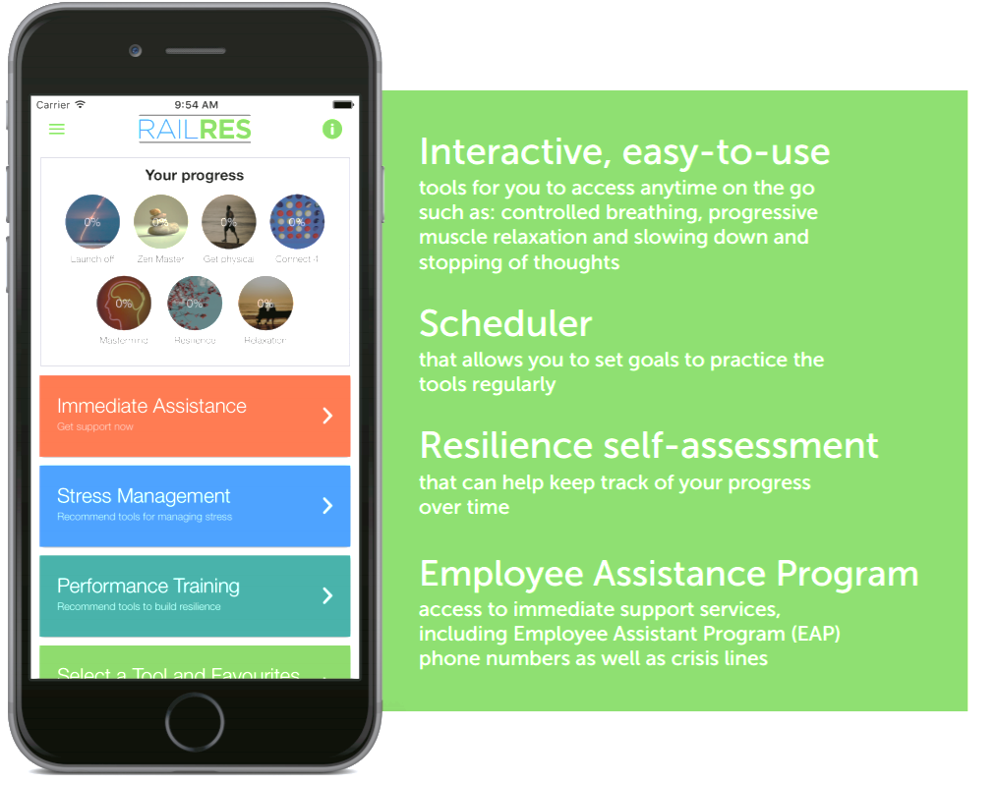
Notes:
Before continuing on with the content of this training, introduce the RailRes app as a tool that will be referred to throughout this training, and a useful resource to use beyond this training. Encourage them to download it today (even during the workshop break).
Facilitator note: Throughout the training, the RailRes logo is placed on slides that cover a skill the same as or similar to skills in the RailRes App. It is important that you are familiar with the app prior to conducting the training.
Below is some information about the RailRes App, as described by TrackSAFE:
The RailRes App is a resource that has been developed by TrackSAFE as part of its suite of trauma management support tools.
The App is designed to assist rail employees in managing stress if exposed to a traumatic event and build long term resilience to help employees stay healthy. The RailRes app has been informed by an industry reference group and the unions, to ensure that the app is relevant and beneficial to rail employees.
The RailRes app will test a rail employee’s physical, cognitive, emotional and behavioural reactions to stress, while helping the user adapt their response to the situation in real time.
The App is available for free download (for both iPhone and Android devices) via the App Store
App features
Access to immediate support services, including Employee Assistance Programs phone numbers as well as crisis lines.
Interactive, easy-to-use tools that the user can access on the go such as: controlled breathing, progressive muscle relaxation and slowing down and stopping of thoughts.
A scheduler that allows users to set goals to practice the tools regularly.
A resilience self-assessment that can help users keep track of their progress over time.
More information, a video, and downloadable posters are available here: http://tracksafefoundation.com.au/railres-app

Slide 8
Session 1: The impact of trauma
Notes:
The impact of trauma – 40 min session
This part of the workshop will take approximately 40 minutes and aims to provide participants with:
a definition of what a PTE is and the kind of psychological hazards participants may be faced with
an understanding of common reactions to PTEs and what makes some people more at risk of developing problems.
For this session you will require:
the TrackSAFE video (optional)
a whiteboard
butcher paper (required if the first exercise (responses to PTE) is conducted as a small group discussion).

Slide 9

Potentially traumatic events
Overwhelming threat to the physical or psychological integrity: i.e., a threat to survival as a person
Notes:
Introduce the concept of a potentially traumatic event (PTE).
Provide a context
Contrast “everyday” stress to “traumatic” stress. We all experience different forms of stress at work: working long hours, too many deadlines, conflict with colleagues, or being performance managed. What we call critical incidents or traumatic events (use appropriate language within your organisation) are quite different in nature and can lead to unique problems.
Before we discuss the types of critical/traumatic incidents that can affect us in our organisation, I would like to provide you with a definition so that we are clear about what we are focussing on.
Present a definition of a PTE
A PTE involves either experiencing or witnessing a situation that involved the threat of death or serious injury. In other words, during a PTE you could be threatened with death, or be seriously injured, or you could witness the death, injury or suffering of others.
We say that an event is ‘Potentially’ traumatic because everyone responds differently.
You can mention that the definition of Critical Incident is the same if this is a term used in your organisation.
Provide example of PTEs, especially those that may arise in the rail industry:
hitting someone while diving a train/tram or being involved in a near miss
witnessing someone being severely injured
seeing body parts while trying to help an accident victim, investigating an incident, or cleaning rolling stock or tracks
being assaulted or severely injured
witnessing an assault.
Ensure that you include a mix of examples that are relevant to different roles in the organisation (e.g., include examples relevant to station staff as well as examples relevant to drivers).

Slide 10
VIDEO: Impact of trauma
Play section from TrackSAFE video that shows staff affected by trauma, including common reactions
Notes:
This video excerpt presents rail staff’s reactions to a number of traumatic events. Play the relevant sections from TrackSAFE video:
Even good jobs have bad days (approx. 30 seconds)
Impacts of trauma (approx. 1 minute)
The video serves as a bridge between providing a definition of PTEs and the exercise aimed at developing an understanding of reactions to PTEs.

Slide 11
Exercise: Responses to PTEs
Feeling distressed is normal: It’s a sign that you’re a human being
Emotions
Feelings
Thinking
Behaviour
Physical
Notes:
Facilitator Note: Remind participants they should protect confidentiality of those involved in previous incidents when relating their experiences
PARTICIPANT EXERCISE (small group or whole group)
5 min small group exercise with 10 min feedback to larger group.
Aims of exercise
To develop an understanding of common reactions following a PTE
To help participants understand that reactions can be varied and that there is not one “normal” response to a PTE.
Instructions
Need to emphasise the difference between initial distress that is a normal response, and prolonged significant distress that may indicate a mental health problem/not coping
Option 1
Ask participants to break into four small groups.
Each group to be allocated a set of reactions:
emotional
cognitive
behavioural
physical
Ask each group to select a person to report back to larger group and to brainstorm problems that a person might have in response to a PTE. Emphasise that there is no right or wrong way to answer.
Option 2
Alternatively, conduct a 15 min discussion with the whole group. This may be a preferred option if time is short or you are training a small group.
During feedback for Option 1 and 2:
stress that a range of reactions is normal – feeling distressed immediately, or feeling numb, or “getting on with things” throughout the aftermath of an incident and a few days later and then experiencing distress
differentiate between examples related to initial distress and prolonged significant distress that may indicate a mental health problem or inability to cope

Slide 12
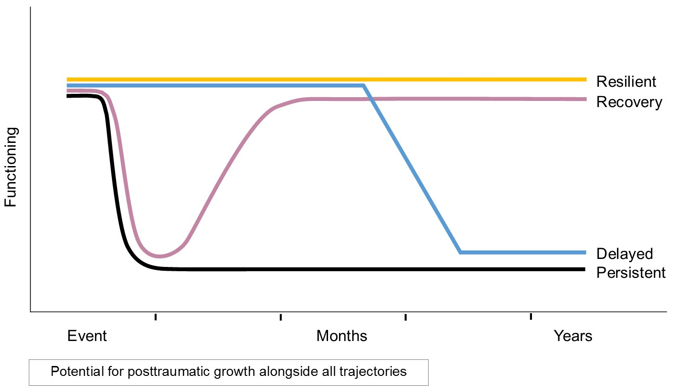
Typical recovery patterns over time
Notes:
In presenting recovery patterns, ensure that the main message conveyed is that, by and large, people can cope with traumatic events and although initial distress can be expected, most people recover. Ensure that the following points are covered:
Before presenting the different types of recovery patterns, stress the difference between initial distress that usually dissipates, and prolonged significant distress that may indicate a mental health problem or need for help. You may wish to use the phrase ‘there are lots of ways people travel after a trauma’ to introduce this graph.
State that most people cope well after a PTE by drawing upon their training, usual coping strategies and support systems.
Explain that responses vary:
feeling temporarily distressed, but bouncing back
being largely unaffected (although some may find the effects are delayed)
feeling strengthened by the event(s)
developing more significant emotional or mental health problems such as depression, anxiety, posttraumatic stress disorder, substance misuse (e.g., alcohol).
Note that the variable response is why people need to be aware of a range of self-help strategies and why a flexible rather than “one size fits all” approach is required when supporting them.
Facilitator note: For your information, these are more detailed descriptions of each of the trajectories. This level of detail is not necessary for participants unless requested.
Persistent: People who follow this course may not recover on their own or with assistance from family and friends, and will develop more severe and persistent mental health problems, drug or alcohol-related problems, or persistent relationship and occupational difficulties.
Delayed: People who follow this course develop mental health issues only after a significant period of time has passed since the trauma.
Recovery: These people display significant mental health problems (i.e.. subclinical or diagnosable mental health disorders) and disruption to functioning for typically at least several months, before returning to healthy functioning.
Resilience: These people may show very little obvious distress or decline in functioning following a traumatic event.
Note that there is the potential for posttraumatic (personal) growth alongside al of these trajectories

Slide 13
Risk factors
Before the event
Anxiety & depression; prior severe critical incident history, burnout
During the event
Degree of life threat; duration; predictability and controllability; intensity of the person’s reaction at the time
After the event
Stressful life events; lack of social support
Notes:
Discuss risk factors for developing difficulties after a PTE.
Provide a context and rationale for discussing risk factors. Risk factors can be present before, during, or after a traumatic incident. While we don’t have control over all risk factors (e.g., the number or types of events a person is exposed to), this workshop may help you manage some of these risk factors by asking you to:
consider activities that may improve your current lifestyle and ability to manage stress
learn skills to manage your immediate reactions to a traumatic event
think about the kind of supports for helping you cope with the impact of PTEs.
Don’t set up expectations of not coping. Stress that not all people who experience these risk factors will go on to develop problems.
Describe different risk factors. Provide some concrete examples in the rail industry context.

Slide 14
Predictors of more serious reactions
Individual response is difficult to predict, but
high-risk situations include:
Person hurt was a child, known to staff, other personal significance
Staff member believes he/she is responsible
Previous fatality or near-miss exposure
Very angry, tearful, numb
No social support, other current life stressors
Notes:
In presenting this slide ensure that the following points are made:
Having experienced these does not necessarily mean that a person will develop serious problems. These risk factors are presented so that should participants experience them they can pay particular attention to their emotional needs and seek extra support.
Increased support, particularly from a professional, may be required in these circumstances.
State that later in the session you will present warning signs for when to seek help.

Slide 15
What to expect after a PTE
<each organisation to insert information on standard organisation procedures after a staff member has experienced a PTE>
Notes:
This slide will need to be modified for your organisation. The aim of this slide is to inform staff of what to expect after experiencing a trauma in terms of organisational procedures (this may include support provided by external contractors to the organisation). This slide should include at least the following information.
Immediate aftermath:
Who will support the staff member in the immediate aftermath of the PTE? For example, first responder?
If applicable to your organisation, it is important to acknowledge that it may take anywhere from minutes to hours for another staff member (e.g., first responder) to attend the scene (e.g., for geographical reasons).
Days and weeks after a PTE:
Who is responsible for the wellbeing of the staff member in the days and weeks following a PTE?
What trauma leave is the staff member entitled to, or what is recommended by the organisation?
Are staff members automatically contacted by EAP and/or peer support after a PTE? (Or does the staff member initiate contact?)

Slide 16
Session 2: Looking after yourself
Notes:
Looking after yourself – 1 hour 50 min session incl. break
This part of the workshop will take approximately 1 hour and 45 minutes and will include a 15 minute break. It aims to provide participants with:
an introduction to the types of coping strategies that are helpful both during and following a PTE
an introduction to the idea that these strategies can be practised immediately so that they are more effectively used at the time of an incident, and can also be practised to help participants improve their current lifestyle and therefore reduce the risk of not coping with a PTE
a list of do’s and don’ts following a PTE
an opportunity to rehearse coping skills including breathing retraining, helpful thinking, and seeking social support.
For this session you will require:
the TrackSAFE video and a whiteboard.

Slide 17
Looking after yourself
Before the event: Prepare
Increase general wellbeing and manage stress better
Practise skills that will help you cope during a PTE
During: Cope
Do’s & Don’ts following a PTE
Skills to help you cope
After: Self-Care
Looking after yourself in the days and weeks after the event.
Notes:
State that you will look at self-help strategies that can help participants cope better before, during and after a PTE.
Explain that you will help them rehearse some of these strategies so that they are better prepared and can:
manage their stress during a traumatic incident
look after themselves more effectively in the days and weeks following that incident.
Also state that, as previously indicated, you will discuss how they can better manage stress and improve their general wellbeing using these skills.

Slide 18
Being prepared
Making sure the bucket doesn’t overflow
Traumatic event
Tired, not eating well
No time for self
Stress at work
Notes:
Using this slide, present the rationale for using self-help strategies as soon as possible and for developing a personal coping plan later in the session:
The skills and strategies that we will teach you to improve your ability to cope with potentially traumatic incidents will be the same as the ones that will help you better manage stress in general.
Regularly practising coping skills is the best way to ensure that you will use them if you are exposed to a PTE.
Improving your ability to manage stress now and improving your lifestyle will put you in a better position to cope with the impact of a PTE. It is harder to cope with an incident if you are stressed, don’t look after yourself, or have no supports in place.
You can think of your capacity to manage stress as a bucket. There is only so much stress a person can handle. If a person has developed habits that put stress on their body and their ability to manage things in their life, it can leave little room for handling a very stressful event. This means that the bucket sits close to full from day-to-day, meaning that when something stressful or traumatic happen the bucket can overflow (i.e., the person can become very distressed).

Slide 19

Improving wellbeing
  Make your life enjoyable
  Make time for things you enjoy
  Stay connected with people who make you feel good
  Keep yourself healthy: regular sleep, healthy eating, exercise
Reduce work stress
  Make the most of your breaks
  Manage your time effectively
  Don’t over-commit: prioritise tasks
  Have holidays
Notes:
Facilitator Note: Refer participants to RAILRES app – this has exercises, called Physical Activity and Healthy Sleep, that participants may wish to use after this training.
Remind participants that people are more likely to cope if they manage stress better and address potential risk factors like feeling burned out at work, or using alcohol to cope with stress.
Take participants through work and general lifestyle recommendations providing examples as needed.
The information on this and the following slide are included in the participant workbook - ‘Improve your general wellbeing’.
Also, refer participants to the pleasant activity list in their workbook as a guide if they would like to have ideas about enjoyable activities they could engage in.

Slide 20
Improving wellbeing
  Practise good coping skills
  Ask for help when you need it
  Don’t rely on drugs & alcohol to feel better
  We’ll cover some of these skills later in the session
Notes:
Present positive coping strategies listed on slide, providing examples as needed.

Slide 21
Exercise: Improving wellbeing
Take a moment to consider the following questions and write down your answers. Do you:
Have regular routines that help you feel good?
Devote enough time to relationships & activities that you enjoy?
Make the most of work breaks & breaks during the holidays?
Tend to over-commit – never say ‘no’?
Are you making time for things that are valued?
<each organisation to insert information on standard organisation procedures after a staff member has experienced a PTE>
Notes:
PARTICIPANT EXERCISE (individual)
5 min individual exercise with 5 min feedback to larger group
Handout from participant workbook – ‘Improving Wellbeing Worksheet’ – is required for this exercise.
Instructions
Ask participants to refer to the ‘Improving Wellbeing Worksheet’ in the participant workbook.
Ask them to reflect on the following questions and write down the answers on the worksheet:
Do you have regular routines that help you feel good (e.g., exercise, reading a book)?
Are you devoting enough time to relationships and activities that are enjoyable?
Do you take regular rests from work – regular breaks during the day as well as holidays?
Do you tend to over-commit – never say ‘no’?
Are you making time for things that are valued?
Do you have regular eating, exercise and sleep patterns?

Slide 22
Managing strong emotions
Strategies that can be used during/after a PTE
Type of response | What can happen | Strategy
Physical | e.g., anxious, sweaty palms, heart racing | Breathing re-training; grounding
Thinking | e.g., “I can’t cope with this” | Simple self-strategy
Behavior | e.g.; freezing, yelling, drinking | Getting support, using time-out, or finding alternative activities
Notes:
Use this slide to introduce the range of strategies that will be covered in this session. Remind participants that PTEs can impact on how a person feels emotionally and physically, on how they think, and on what they do. In other words, when a person is distressed during or in the aftermath of a traumatic event, they may need different strategies to address physical symptoms of stress, negative thoughts, and unhelpful behaviours.
You can refer participants to a case study in their handbook illustrating how different strategies can help address physical and emotional responses as well as thoughts and actions. The case study is not meant to be used in the session as participants will work through to case studies later on in the workshop; rather it is a resource to be used as an overview and reminder after the training.

Slide 23
Exercise: Controlled breathing
Count to yourself
“IN, TWO, THREE’
“RELAX, TWO, THREE’
1 2 3 4 5 6
SECONDS
Notes:
PARTICIPANT EXERCISE (individual)
5 min individual exercise: skill demonstration
Facilitator Note: Refer participants to RAILRES app – this has an alternative (but similar) exercise that participants may wish to use after this training.
Aims of exercise
Help participants rehearse controlled breathing skill
Demonstrate benefit of controlled breathing
Instructions
Take participants through controlled breathing exercise (without explaining the theory behind it):
Step 1: Ask participants to breathe normally and count their breath when they breathe out: “breathe in, breathe out one, breathe in, out 2, etc…” Tell them you will time them for one minute and ask them how many breaths they have counted. Write number next to initials on whiteboard.
Step 2: Give participants the following instructions. ‘I will now teach you a different way of breathing. Take a normal breath in to the slow count of 3, and then breathe out to the slow count of 3. As you breathe out say the word “calm” or “relax” to yourself. When you do this exercise it is best not to shallow breath, i.e., high in your chest, but rather to breathe right down to your diaphragm. To do this, it can be useful to put a hand on your chest and stomach - as you breath in try to have the hand on your stomach move in and out, rather than the hand on your chest move up and down.’
Step 3: Continue to breathe in and out slowly through the nose for one minute.
Step 4: Ask participants to repeat Step 1 and compare breathing rates. After practising this technique in the workshop participants are likely to have found that breathing rate decrease from the Step 1 to a more relaxed breathing rate.
Explain to participants that they can use the technique in a couple of ways that will assist them to feel more relaxed when they feel intense emotions, are stressed, or over-breathe:
Using this skill for 2-3 minutes each day will help them be more relaxed from day to day (could refer to bucket analogy), i.e., they will have a lower resting/baseline breathing rate.
Regular practice makes it more likely that they will use this skill (and it be effective) in more stressful situations.
Refer to participant workbook telling them they have a handout with instructions – ‘Controlled Breathing Exercise’.

Slide 24

Grounding
Shifting attention away from negative feelings
Notes:
Facilitator Note: Refer participants to RAILRES app – this has an alternative (but similar) exercise that participants may wish to use after this training.
Present an overview of grounding techniques:
Grounding is a simple strategy you can use to distract yourself from strong negative emotions (e.g., anxiety, anger). Distraction works by focussing on the external world, rather than on internal feelings or physical responses to anxiety. It can help you feel in control again.
Grounding can be done at any time and anywhere. You can even do it in public, and no one will know.
There are different grounding techniques – you can pick the one that suits you most.
Describe your environment in detail, using all your senses, for example, “The walls are grey; I am sitting on a green chair …” Describe sounds, textures, colours, smells, shapes, numbers, etc…. You can do this anywhere.
You can use counting to help focus: 5 things I can see; 5 things I can smell;
5 things I can feel; 5 things I can hear; then go down to 4, 3 , 2 and 1.
You can also focus on your senses: Touch objects around you and describe them (texture, colour); feel the chair/steering wheel, etc.; run your hands under water.
When doing grounding, avoid any assessments or judgments about what is happening. Simply focus on concrete descriptions of what is around you and move on.
Focus on the present, not the past or the future.
Grounding is not the same as relaxation training. Grounding uses distraction so you can get away from bad feelings, and is intended to help manage strong negative emotions.
Refer to relevant section of participant workbook, telling them they have a handout with instructions – ‘Grounding’.

Slide 25
Brief muscle relaxation
Where in your body do you feel tension?
Take a small breath and hold for 6 seconds.
At the same time, gradually tense the chosen muscle group
After 6 secs, breathe out slowly saying the word ‘calm’ or ‘relax’ to yourself. At the same time gradually let the tension go from your muscles
Repeat if necessary with same or other muscles
Notes:
Facilitator Note: Refer participants to RAILRES app – this has an alternative (but similar) exercise, called Progressive Muscle Relaxation, that participants may wish to use after this training.
Present an overview of brief muscle relaxation:
Brief muscle relaxation is a simple strategy you can use to reduce stress-related tension in your body. It can be done at any time and anywhere.
Steps of brief muscle relaxation:
Pay attention to your body and consider, where in the body to you feel tension? For many people, stress-related tension is commonly felt in shoulders, neck and stomach muscles.
Take a small breath and hold for 6 seconds. At the same time, gradually tense the chosen muscle group, e.g., shoulders.
After 6 seconds, breathe out slowly saying the word ‘calm’ or ‘relax’ to yourself. At the same time, gradually let the tension go from the chosen muscle group, e.g., shoulders.
Repeat if necessary with same or other muscles where you feel tension.
Refer participants to the relevant page of the participant workbook – ‘Brief muscle relaxation exercise’.

Slide 26
Introducing helpful thinking skills
With this skill, the aim is to help yourself to:
Learn to identify what you are saying to yourself about a PTE or your current situation and to choose less distressing ways of thinking
Consider using this skill as a way of:
  coping better during or after PTE,
  increasing your wellbeing in day-to-day life
Notes:
Briefly present the aims of teaching this set of skills: to both increase coping during and immediately following a PTE, and to promote life skills to increase wellbeing.

Slide 27
Common thoughts about PTEs
“Things will never get better”
“I can never feel safe again”
“It’s their fault this happened”
Overwhelmed,
helpless
Nervous,
tense
Angry,
agitated
Notes:
Describe types of negative thoughts often experienced during or immediately following a PTE:
During a PTE, people may tell themselves things that reinforce how overwhelmed or distress they feel: “This is too horrible, I can’t bear this”, “I can’t breathe, I’m going to choke”.
After a PTE, it is common for people’s thoughts about the world and themselves to change. For example, staff who have experienced a PTE often see the world as stressful, unpredictable, or a dangerous place. They may have trouble trusting other people or see their situation as hopeless.
Explain that distress is reinforced by negative thinking. These types of beliefs can lead to intense and ongoing distress. Thinking that “absolutely nothing is going well”, or “things will never get better”, can leave a person feeling hopeless and overwhelmed. In the same way, thinking that “I will never be safe again” can lead to feeling tense and anxious.
The main aim of using this coping skill is to reduce distress by at least considering alternative more helpful ways of viewing a person’s situation. The goal is not to eliminate unhelpful thoughts or replace unhelpful thoughts with more helpful thoughts. Remind audience that a focus on helpful ways of thinking can improve our mood and adaptive coping
Don’t debate with trainees whether or not their thoughts are justified; focus on whether they are helpful
You may wish to say: “After a PTE, it is common for people’s thoughts about the world and themselves to change. For example, staff who have experienced a PTE often see the world as stressful, unpredictable, or a dangerous place. They may have trouble trusting other people or see their situation as hopeless. Understandably, people feel deeply upset by things that happen during an incident. However, it helps to know that people under stress can develop habits of thought that actually make their situation even worse by increasing feelings of distress. “Unhelpful” habits of thought might include thinking that, “Absolutely nothing is going well”, or “Things will never get better.” We call these thoughts unhelpful because they can make it even more difficult to deal with the situation by increasing feelings of being overwhelmed or hopeless.”

Slide 28
The way you think can help you cope
Feelings
What you do
What you think
Physical state
Telling yourself to feel good does not work
It is easier to change what you do or think, which will in turn change the way you feel
Notes:
Provide an introduction to Helpful Thinking skills.
Remind participants that they can manage distress or modify negative emotions by changing their thoughts, physical state (e.g., controlled breathing), or behaviours (e.g., following procedures during an incident or asking for support immediately following the incident).
Introduce how different thoughts bring about different feelings using an example: ‘Today we are going to talk about how the way you think about things can change the way you feel. Let me give you an example about two different people. One morning, the first person wakes up and sees that it is raining hard outside. He thinks, “This is horrible! The traffic is going to be terrible on the way to work and I’ll be late for the meeting. And I bet the boss is going to give me a hard time for turning up late.” What do you think he is feeling? The second person wakes up and sees the rain. He thinks, “This may work in my favour. Even if I leave for work earlier, I’m sure I’ll be late to work but at least it means I’ll get to miss the beginning of the boring meeting. Others will probably be late too, so the boss can’t really get annoyed.” What do you think he is feeling? You see, how they thought about the rainy day made them have very different feelings.’

Slide 29
Helpful thinking is not positive thinking
“Positive thinking” is not always realistic or accurate
Negative thoughts may be (at least partly) accurate – even if they are unhelpful
An over-focus on negative aspects of an experience often leads to more distress
Focus on helpful thoughts can mobilise & energise
Notes:
Facilitator Note: This slide is particularly relevant if you have a number of people in the room who have experienced a traumatic incident. This presentation will help them feel engaged and not judged by the focus on helpful thinking. However, its contents may feel much less relevant and somewhat abstract for those who have not had a traumatic experience and you may wish to skip, or very briefly cover the content, if you believe that no one in the room (or a minority) has had this experience.
Explain that developing more helpful thinking is about looking at alternative ways of thinking about a situation, not denying the person’s experience. Present the following points:
The main aim of using this skill is to reduce distress by at least considering alternative, more helpful ways of viewing a person’s situation. The goal is not to eliminate negative thoughts or to replace them with thoughts that have nothing to do with the person’s situation like, “everything is all right”.
“Positive thinking” is not always realistic or accurate. Often you hear people say things like, “If you’d only see things more positively, you’d be OK”. This does not acknowledge that people who have experienced trauma have come into contact with the darker side of life (e.g., death, someone being assaulted, or suicide), and may be worried about their reactions (e.g., nightmares, panic when reminded of trauma, etc.).
However, an over-focus on negative aspects of an experience leads to more distress. This needs to be balanced with thinking about other aspects of a person’s experience, e.g., “I’ll never get better again” versus “I will struggle for a while but I know my family will stick with me”.
Focussing on helpful thoughts can mobilise and energise.

Slide 30
Exercise: Practise helpful thinking
Identify your most frequent unhelpful way of thinking
Complete the entries on the worksheet to address this unhelpful thought
(What do you expect the outcome to be?)
Rehearse the more helpful way of seeing things under your breath
Spend a few minutes “seeing” yourself in a situation when this unhelpful thinking occurs, then rehearse the more helpful way of thinking again
Notes:
PARTICIPANT EXERCISE (individual)
5 min demonstration, 10 min individual exercise, 5 min feedback
Handouts from participant workbook – ‘Helpful Thinking Examples’ & ‘Helpful Thinking Worksheet’ – are required for this exercise.
Facilitator Note: Refer participants to RAILRES app – this has an alternative (but similar) exercise that participants may wish to use after this training. These exercises are called Thought stopping, Quick ways to reassess your thoughts and Challenging thoughts.
Aims of exercise
To help participants practise identifying negative thoughts.
To help participants practise developing more realistic, helpful way of thinking.
To help participants see the potential benefit of helpful thinking skills.
Instructions
Refer participants to ‘Helpful Thinking Examples’ and ‘Helpful Thinking Worksheet’.
Before asking the participants to complete the exercise, conduct a 5 minute demonstration. On the whiteboard, discuss and write up an example of the complete worksheet. Choose an example relevant to the audience, but it does not need to be an example related to a traumatic incident.
After the demonstration, provide the participants with the following instructions:
Using the ‘Helpful thinking examples’ for assistance, identify your most frequent unhelpful way of thinking during the last week.
Based on the helpful thinking examples, and using your own words, complete the entries on the worksheet to address this unhelpful thought. (What do you expect the outcome to be?)
Rehearse the more helpful way of seeing things under your breath. Spend a few minutes “seeing” yourself in a situation when this unhelpful thinking occurs, then rehearse the more helpful way of thinking again.
Brief large group feedback discussion where some participants are invited to discuss how they found the exercise. Make sure that those who want to opt out of this discussion can. “Would anyone like to comment on how they found doing this exercise? What was hard/easy about it?”

Slide 31
Exercise:
Coping better during a PTE
James, near miss incident
47 year old freight train driver
Experienced driver
Involved in 2 previous incidents – both fatalities
Deeply affected by last one – off work for a month
Has to wait as incident occurred in isolated area
Derek, seeing body parts
27 year station staff
Still ‘learning the ropes’
No previous exposure
Man falls onto the tracks and hit by incoming train
Jumps down to see if man can be helped
Notes:
PARTICIPANT EXERCISE (whole group)
10 min discussion as a whole group
Aims of exercise
To review how the strategies discussed thus far in the workshop can be applied during a PTE.
Instructions
Two case studies are provided, although you may wish to modify the slide to only discuss the case study most relevant to the participants attending the workshop.
Encourage the group to consider and discuss potential strategies to use during and after these PTEs, and differences in needs and potential impact of these strategies for James and Derek.
For example, when discussing what each person can do during the PTE to better cope in each of these cases, the following points could be made:
relaxation and breathing techniques can help manage the physical reactions to a trauma (e.g., racing heart, hyperventilating)
knowing ahead of time what procedures need to be followed can be useful
using helpful self-talk/thinking to keep focus on the task at hand can be useful
strategies such as these may help minimise stress during a PTE.

Slide 32

Exercise: Self-care after a PTE:
Tackling myths
If I tell my colleagues, they will think I’m weak
Taking a lot of time off work is necessary for recovery
Having a few drinks helps
settle my mind and get me
to sleep
Talking makes it harder to get over it
I don’t feel anything so I must be OK. Better to let things be.
Notes:
PARTICIPANT EXERCISE (whole group)
10 min group discussion
Aims of exercise
Help participants identify myths about coping
Help participants start to distinguish between coping behaviours that are helpful and those that are unhelpful.
Instructions
Present myths about coping with PTEs listed on the slide.
Ask participants to briefly discuss any other beliefs they or their colleagues have about what helps people cope with trauma.
Write on whiteboard using two columns labelled “helpful” and “unhelpful”.
Discuss helpful versus unhelpful strategies (Refer to information on the Do’s and Don’ts slides).

Slide 33
VIDEO: Looking after yourself
Play section from TrackSAFE video that shows staff affected by trauma, talking about self-help strategies
Notes:
Optional – This video is very brief and you may wish to use it if you think it will assist with better engaging the participants.
This video excerpt presents staff discussing coping strategies that they use to manage their response to a traumatic event.
Play relevant section from TrackSAFE video:
Looking after yourself (approx. 1 minute)

Slide 34

Self-care after a PTE
Spend time with people who care
Give yourself time
Find out about impact of trauma and what to expect
Try to keep your routine
Return to normal activities
Talk about how you feel or what happened when ready
Do things that help you relax and that you enjoy
Notes:
Present recommended coping strategies to cope with PTEs (Do’s) listed on slide, providing examples as needed.
If you have played the TrackSAFE video excerpt, this slide and the following slide can be presented quickly, highlighting those dot points that were not covered in the video.

Slide 35

Self-care after a PTE
Increase alcohol or drugs use to cope
Work too much
Engage in stressful family or work situations
Withdraw from family and friends
Stop yourself from doing things that you enjoy
Avoid talking about what happened at all cost
Take risks, e.g., dangerous driving, picking fights, etc.
Notes:
Present negative or potentially harmful strategies to cope with PTEs (Don’ts) listed on slide, providing examples as needed.
Refer participants to the relevant page in the participant workbook – Self-care after a traumatic event; Do’s and Don’ts after a traumatic event; explaining that they have a list of do’s and don’ts in their workbook, and tips for self-care after a PTE.

Slide 36
Connecting with others
Getting support from those you love and trust is one of the most important things to do to recover from a traumatic incident.
Make sure that you get help from:
friends
family
people you trust in your workplace and community, e.g., people you connect with from sports, hobby or church group
Notes:
Facilitator Note: Refer participants to RAILRES app – this has an alternative (but similar) exercise, called Social Connection, that participants may wish to use after this training.
Introduce the role of social support in coping with PTEs by covering the following points:
Provide a rationale for focussing on social support. Explain that good social support is the best predictor of recovery, “People with good support networks tend to cope better with the impact of a traumatic event. Getting support from those you love and trust is therefore one of the most important things you would need to do if you were exposed to a PTE”.
State the aim of this section of the workshop. Explain that the aim is to help participants think about how they might connect with social support networks, such as family, friends, colleagues and community organisations (e.g., church, sport or hobby group) in order to cope better with the aftermath of a PTE - “One of the goals of this workshop is to help you think about all the people in your life who could support you. Often there are people available for support who many of us do not think of accessing in times of stress. It is easy to forget the people who one sees or talks to every day can be important support systems, including family members (even children) and co-workers.”
Briefly describe how relationships can be disrupted by a traumatic experience. Explain that people can experience disruptions in their support network following a PTE for a number of reasons. For example:
Some people may feel overwhelmed and isolate themselves from their family, friends and/or co-workers.
Others may want to talk about their experiences but are struggling to find someone to listen, because people are not sure about how to react or how to help.
Some may be afraid of “burdening” their family, friends or co-workers with their problems.
For some, the person who is their main source of support at work may have gone through the same incident and they may be avoiding that person because they feel they are not ready or able to talk about what happened.
Finally, briefly address the role of negative relationships in coping with the immediate aftermath of a PTE. State that relationships at home or at work that are not supportive can hinder recovery after a PTE, and that there will be time to reflect during this session on when social support is not working and how to improve participants’ current social networks.

Slide 37
Types of support
People can support you in many different ways:
Practical support
e.g.: a colleague helping with paper work or taking a shift
Emotional support
e.g.: a friend listening to what happened to you; a spouse or partner spending time with you, not necessarily talking about the incident.
Notes:
Introduce this slide by saying that many people think of seeking support as a sign of being “weak”, or that it is not what they need. They may think it’s only about talking about how they feel, or only relevant if they are no longer coping and need someone to “pick up the pieces”. Explain that there are many different kinds of support someone can access when faced with a stressful situation:
Practical support. Provide a few examples from the list below. If time permits, ask participants to generate examples:
A co-worker helping with paperwork or taking a shift.
A neighbour mowing the lawn for you.
A family member babysitting for you so you can relax or talk to someone about what happened.
A supervisor making sure you have the time off that you need and providing you with all the contact numbers you need.
Emotional support. Provide a few examples from the list below. If time permits, ask participants to generate examples:
A friend or family member listening to your experience.
A partner or child spending time with you doing things you like, not necessarily talking.
Someone, or a pet, being companionable – just being there for you.
A friend or co-worker giving you a hug when you need it.
Someone giving you space when you need it.
Refer participants to the relevant page of the participant workbook – ‘Connecting with others’.

Slide 38
Exercise: What kind of support do you have access to?
SELF
Professional
Family
Manager
Community
Work peer
Friends
Notes:
PARTICIPANT EXERCISE (individual)
10 min individual exercise, 5 min feedback
Handouts from participant workbook – Connecting with Others Worksheets 1 & 2 – are required for this exercise.
Aims of exercise
To help participants identify different spheres of support available.
To stress importance of going to already-established sources of support, not just relying on what is offered by work.
To start thinking about what needs to go in a self-help plan.
Instructions
Refer participants to ‘Connecting with Others’ worksheet. Ask participants to spend some time considering the following questions and then fill-out their ‘social connections map’ on the worksheet.
Who are your most important sources of support at present?
Who can you, or do you want to, spend time with socially at present?
Who can you share your experiences or feelings with?
Who provides you with practical support when you need it, both at work and at home (e.g., help with tasks, willing to babysit for you, or clean the house)?
Who can you count on, no matter what?
Who or what (including pets), provides you with companionship?
Also ask participants to identify what might need to be changed in their support network by answering the questions listed on the second page of their worksheet:
Are there areas of your life where support is missing (e.g., someone to listen to you, help with the additional responsibilities, to do things socially with you?)
Are there loved ones or friends who you are not currently connected with but would like to be?
Who do you want to spend more time with?
Who do you want to spend less time with?
Are there some relationships that need improving?
Do you want to increase your social activities or give to others by joining a community group?
Conduct a brief large group feedback discussion where some participants are invited to discuss how they found the exercise. Make sure that those who want to opt out of this discussion can: “Would anyone like to comment on how they found doing this exercise? What was hard/easy about it?”

Slide 39
What if I don’t want to talk?
There are alternatives to withdrawing entirely from your supports:
  Talk in your own time
  Spend time with people doing other things
  Set limits - “I’m not ready yet…”
  Some people push everyone away to avoid talking about what happened
Notes:
The content of this slide is designed for people who are afraid of being overwhelmed if they talk about a traumatic incident or about how they feel. Following a traumatic event some people can isolate themselves for these reasons. This slide provides alternatives to withdrawal or isolation by providing solutions that still enable a person to be connected to others while not necessarily having to talk about what happened or about how they are feeling. In presenting this content you need to cover the following:
Introduce the need for alternatives to social withdrawal.
“Some people are afraid of being overwhelmed if they talk about a traumatic incident or about how they feel. For some that fear may lead them to withdraw from others and to isolate themselves. As we have discussed already, it is not always necessary to talk about feelings or a traumatic experience to get support. I will present a few alternative solutions that can help a person to stay connected with other people while not necessarily having to talk about what happened or about how they are feeling.”
Briefly describe alternatives to withdrawing from others.
There is no rule about when to talk about what happened or when to share your feelings. Some people find it beneficial to talk about what happened after a PTE, others need to process it on their own at first or want to focus on other things in their life. You don’t have to talk about what happened or how you feel, even if people ask you. If you choose to talk, you can talk in your own time, to the person of your choice.
You can spend time with people without having to talk about your experience or your feelings. Playing a game of cricket with friends, spending time with your children, or going on regular walks with your partner may be just as beneficial. Sometimes people need to know what you need and telling them what you want to do with them can be a huge relief and will help them to be there for you.
You can set limits for people without pushing them away completely. You could tell your partner, friend or co-worker things like, “I’m not ready to talk about it. I’ll let you know if I need to”, or “I’d rather we talk about other things. Let’s keep talking about the renovations we planned”. It may be useful to rehearse statements for these situations so that you don’t have to think about them too much or struggle to find the right words when confronted with people who are asking questions you don’t want to answer.

Slide 40
Session 3: Getting help and personal coping plan
Notes:
Getting help and developing a personal coping plan - 45 min session
This part of the workshop will take approximately 45 minutes and aims to provide participants with:
an understanding of warning signs of more serious emotional problems or an inability to cope, and when to seek help
an awareness of the type of help available (e.g., peer support, line supervisor, EAP)
an opportunity to develop a personal coping plan that includes:
strategies they can start to use immediately in order to be better prepared should they be exposed to a PTE
strategies to improve their current lifestyle
coping skills they would like to use during or immediately following an incident
a list of potential sources of support and help
an opportunity to familiarise themselves with the resource kit made available to them to help them look after themselves following a PTE
an opportunity to evaluate the workshop.

Slide 41
VIDEO: The importance of support
Play section from TrackSAFE video that shows staff talking about accessing supports
Notes:
This video excerpt presents staff discussing the importance of accessing support, and types of supports available.
Play the relevant the section from TrackSAFE video:
Importance of support (approx. 1 minute 30 seconds)

Slide 42
When to seek help
Change in behaviour - e.g., “I can’t do the things I used to do”; “She is just not the same since that day”
Problems are interfering with work or personal life
No or very few signs of improvement after two weeks
You’re worried about yourself
Others are concerned about you - “Hey, you look like you’ve been struggling a bit lately. Are you OK?”
Test your resilience on RailRes
Notes:
Facilitator Note: There is a brief questionnaire on the RailRes app, called Test your Resilience, that participants may find helpful to track their progress. Note this is not a diagnostic questionnaires.
In introducing this slide it is important to cover the following points:
Put help-seeking in context by reiterating the message that recovery is the most likely outcome of experiencing a PTE. In other words, don’t set up expectations that people won’t be able to cope or will be “damaged” by a traumatic experience. Remind participants that many people cope well after a traumatic incident, or recover from their initial distress a few days or weeks later. Explain that it is nonetheless important to understand when to seek help in order to recover quickly if they feel overwhelmed or struggle to cope with a PTE.
Describe signs of seeking help as listed on slide. Provide concrete examples as needed.

Slide 43
Other signs
Anxious, tense or blue?
Drinking more than usual?
Using medication or drugs to help?
You or someone worried about your drinking/drug use?
Withdrawing from everyone?
Notes:
Describe signs for seeking help as listed on slide. Provide concrete examples as needed.
State that using drugs and alcohol to cope (e.g., to help with sleep, to feel less anxious or to numb feelings) is a common response and that this can spiral out of control if it is the only coping mechanism the person is relying on. State that moderating drinking or use of drugs after an incident can help ensure recovery.
Explain that withdrawal from others is also a common response, and that sometimes a professional can help a person find a safe way to reconnect with other people and get the support they need.

Slide 44
Other signs
Have you had nightmares about it or thought about it when you did not want to?
Tried hard not to think about it or went out of your way to avoid situations that reminded you of it?
Were constantly on guard, watchful, or easily startled?
Felt numb or detached from others, activities, or your surroundings?
Notes:
Describe signs of seeking help as listed on slide. Provide concrete examples as needed.
Explain to participants that these four types of problems are common responses to traumatic incidents and that for many people these will dissipate in the days and weeks after the incident. State that if these problems last longer, or have an impact on a person’s ability to work or engage in day-to-day activities, they may indicate the need for professional help.
Note that these questions are based on the Primary Care PTSD Screen (PC-PTSD). You do not need to state this to participants as this may overload them with information and would not be relevant at this stage. However, if you get enquiries from participants about this set of questions, particularly from those who have had previous PTEs or have developed PTSD, the reference is:
Prins, A., Ouimette, P., Kimerling, R., Cameron, R. P., Hugelshofer, D. S., Shaw-Hegwer, J., Thrailkill, A., Gusman, F.D., Sheikh, J. I. (2003). The primary care PTSD screen (PC-PTSD): development and operating characteristics. Primary Care Psychiatry, 9, 9-14

Slide 45
Getting help
HELP
General Practitioner
Peer Support
Supervisors
Employee Assistance Program (EAP)
Private Psychologist/ Counsellor
Notes:
Discuss support options for staff, e.g., EAP, peer support network, supervisor, management, professional counselling or treatment services.
Refer participants to the ‘Getting help’ handout in the participant workbook. It provides a list of support options available through the organisation as well as services that participants might find useful (e.g., confidential 24 hour helplines, database of psychologists). The handout also allows participants to add contact details of people in the organisation and professionals they trust (e.g., their GP).
Ensure that you leave some time for participants to ask questions about available support options if they need to.

Slide 46
Looking after yourself:
Drafting a plan
Make a commitment to improve your wellbeing & practise strategies that will help you cope during a PTE
PREPARE Before a PTE | COPE During a PTE | SELF-CARE After a PTE
1-2 skills you can practise to manage stress during a PTE | Skills to help you cope | Skills to help you recover
1-2 things you can do at work to improve wellbeing | Procedure to follow | Support at work
1-2 things you can do at home to improve well being | Who to call | Support at home & activities that help you feel better
Notes:
In introducing the personal coping plan, ensure that you cover the following topics:
Introduce the 3 elements of the personal coping plan:
Prepare before a PTE: consider skills to practise in order to better manage distress should you experience a PTE, and strategies for improving your wellbeing at work and at home.
Cope during a PTE: list the skills, procedures or immediate supports to contact at the time of an incident.
Self-care after a PTE: consider coping skills you may use and people who may support you at home and at work.
Ensure that people focus on a range of strategies. Explain that in thinking about self-care after a PTE or improving current lifestyle, it is important to focus on what can be done both at home and at work.
Briefly describe the principles of an effective plan. State that the strategies they are putting in their plan should be specific, realistic and measurable. Provide one or two examples: “Writing down that you will try to relax after work, for example, is not specific enough. It is hard to keep track of what you will do, when, or how. That makes it more difficult to make a commitment to do it. On the other hand, you could write down, ‘Every day after I get home from work, just before dinner, I will go for a 20 minute walk with the dog’.”
Briefly review the rationale for starting to practise coping strategies as soon as possible, and for developing a personal coping plan. When presenting this slide, remind participants that:
the skills and strategies used to improve your ability to cope with potentially traumatic incidents are the same as the ones that will help you better manage stress in general
regularly practising coping skills is the best way to ensure that you will use them if you are exposed to a PTE
improving your ability to manage stress now and improving your lifestyle will put you in a better position to cope with the impact of a PTE. It is harder to cope with an incident if you are stressed, don’t look after yourself, or have no supports in place.

Slide 47
Exercise: Complete coping plan
  Only include activities that you’re confident you’ll use, rather than activities you think you “should” do
  Highlight the activities that you plan to practise (e.g., controlled breathing) – see last box on your plan
  Make a note of when you’ll practise them,
  e.g., put daily reminder with alert in your phone to practise controlled breathing for next month
Notes:
PARTICIPANT EXERCISE (individual)
10 min individual exercise, 5 min feedback
Handout from participant workbook – ‘Personal Coping Plan’ – is required for this exercise.
Aims of exercise
To help participants identify sources of support and self-help strategies they would use to cope better during and following a PTE or to improve current ability to manage stress.
To encourage participants to prioritise one or two strategies that they can start practising immediately.
To ensure that participants have a written record of what would help them cope better.
Instructions
Refer participants to the personal coping plan handout in their workbook and ask them to complete the plan.
Conduct a brief large group feedback discussion where each participant is asked to name one thing they plan to try out to improve their wellbeing. It is important to allow people not to provide feedback if they choose not too: “If you do not want to provide feedback or are not sure about what you want to do, it’s OK to say: ‘I will need to think about this or I’m not sure yet’.”

Slide 48
Notes:
Remind participants of the RailRes App and encourage them to download it today.
Remind participants of the activities that are relevant to the skills discussed during the workshop:
Physical Activity
Healthy Sleep
Controlled breathing
Grounding
Progressive Muscle Relaxation
Thought Stopping
Quick Ways to Reassess your Thinking
Challenging Thoughts
Social Connection
Inform participants of the other features and skills on the App that they may find useful:
Goal setting and ability to track progress
Distraction
Emotional Control
Controlling Anger
Facilitator Note: Below is some information about the RailRes App, as described by TrackSAFE:
The RailRes App is a resource that has been developed by TrackSAFE as part of its suite of trauma management support tools.
The App is designed to assist rail employees in managing stress if exposed to a traumatic event and build long term resilience to help employees stay healthy. The RailRes app has been informed by an industry reference group and the unions, to ensure that the app is relevant and beneficial to rail employees.
The RailRes app will test a rail employee’s physical, cognitive, emotional and behavioural reactions to stress, while helping the user adapt their response to the situation in real time.
The App is available for free download (for both iPhone and Android devices) via the App Store
App features
Access to immediate support services, including Employee Assistance Programs phone numbers as well as crisis lines.
Interactive, easy-to-use tools that the user can access on the go such as: controlled breathing, progressive muscle relaxation and slowing down and stopping of thoughts.
A scheduler that allows users to set goals to practice the tools regularly.
A resilience self-assessment that can help users keep track of their progress over time.
More information, a video, and downloadable posters are available here: http://tracksafefoundation.com.au/railres-app

Slide 49
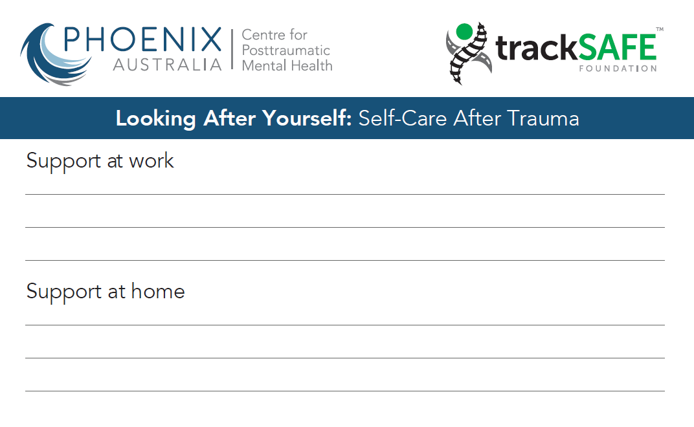
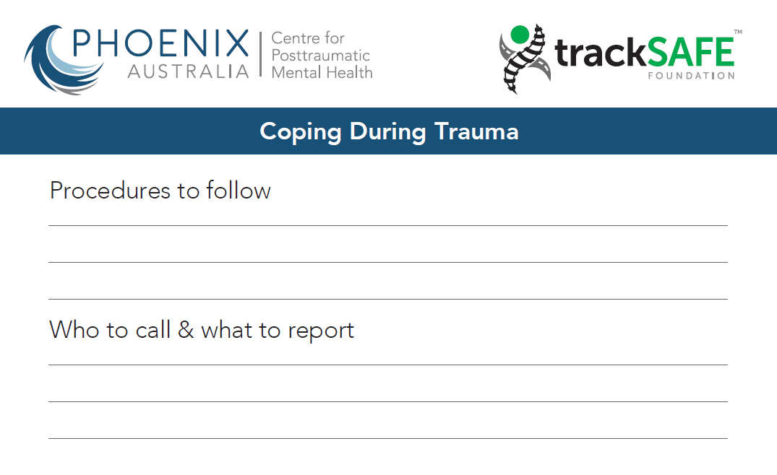
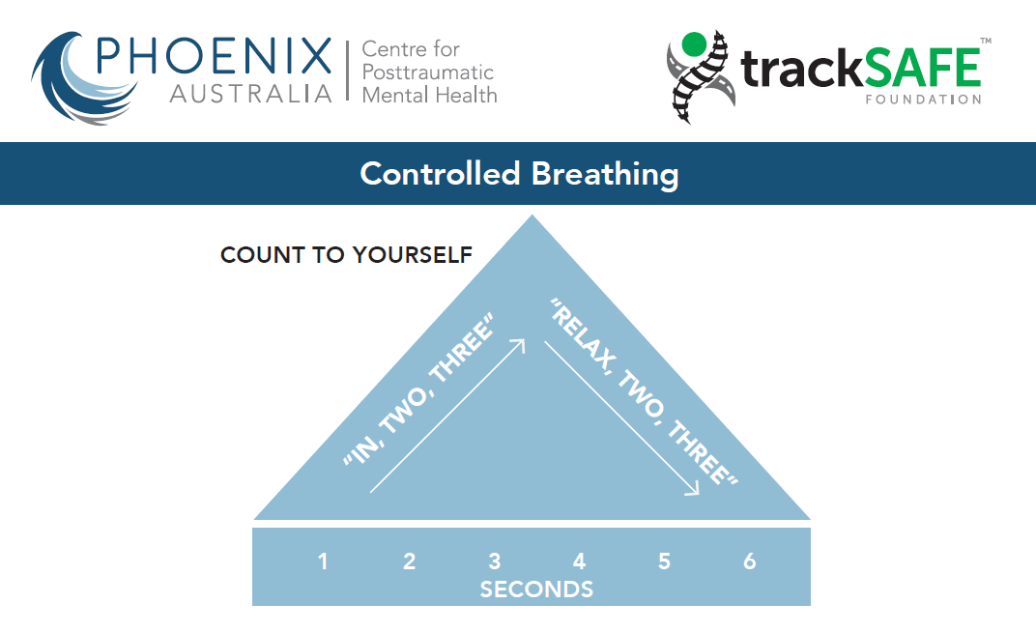
Prompt cards
Notes:
This slide will need to be modified for your organisation.
The aim of this slide is to inform staff about the prompt cards that have been provided (in soft copy) with this training package. This slide does not include all the prompt cards that are relevant to the Coping with Trauma workshop. Refer to the soft copy of the ‘Prompt Cards’ that are provided.
It is up to each organisation whether they print and provide these to their staff. Delete this slide if your organisation is not going to provide these.

Slide 50
Conclusion
Questions?
Please complete workshop evaluation form
Notes:
At the end of the workshop, make sure that you:
ask if participants have any questions, and address any remaining issues or concerns
ensure all participants have completed the attendance list (Refer to Appendix of Trainer Manual – General) and evaluation materials (see Appendix 2)
thank the participants for their involvement.
A discussion of the evaluation process at the end of the workshop is crucial. It is vital that participants provide feedback about how useful they found the training and which parts they felt were most useful or relevant. It is only by getting this information that the organisation can modify the training to ensure it meets the needs of staff. Distribute the relevant evaluation forms and make sure everyone understands what is expected of them.

Slide 51
Coping with Trauma
Thank you
Notes:
Thank participants for their attendance and participation.

